Slide 1
Week 5
ViLBert & VisualBert

Slide 2
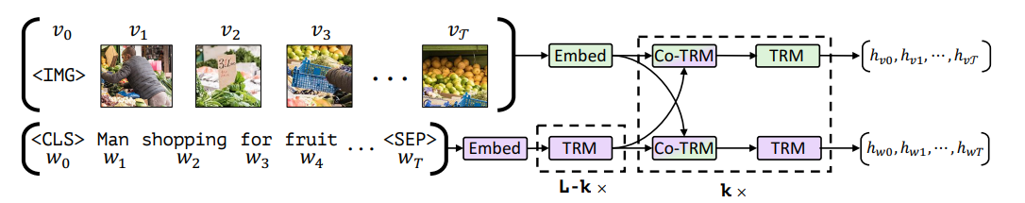
ViLBert
Architecture
Co-TRM
Pre-train

Slide 3
Architecture
Produce image feature with Fast R-CNN
Co-attentional transformer layer
ViLBert consists of two stream for visual and linguistic process, and interact through novel co-attentional transformer layer

Slide 4
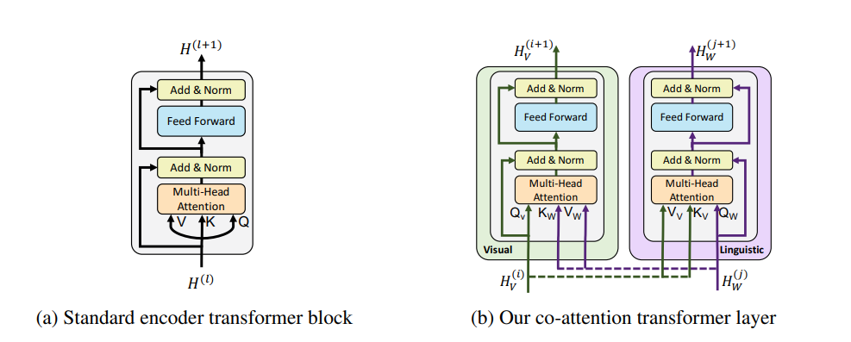
Co-TRM
Share ‘K’ and ‘V’ with other stream

Slide 5
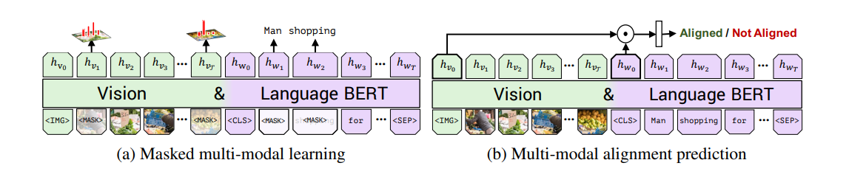
Pre-train

Slide 6
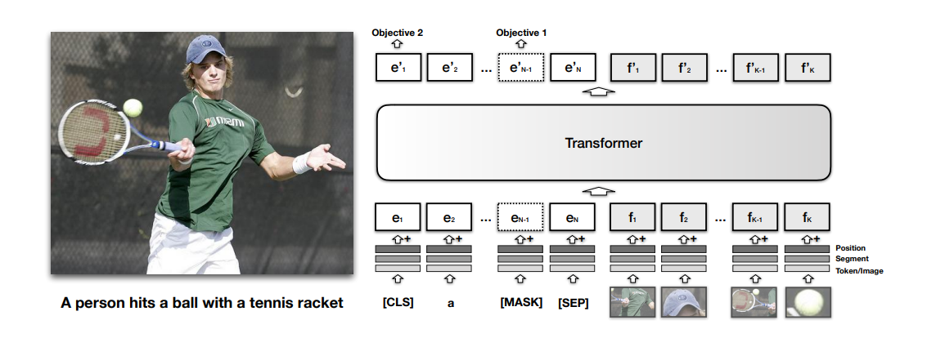
VisualBert
Produce image feature with Fast R-CNN or other network
Like ViT, VisualBert interact image feature and text to Bert.

